Slide 1
Addressing Bus Bunching
Bus bunching is a well-known urban transportation problem
It occurs when multiple buses on the same route bunch together, leaving long gaps in service followed by a cluster of buses, which leads to uneven passenger distribution, increased wait times, decreased efficiency, and general commuter frustration.

Slide 2
Toronto Bus Delay 2022
This dataset is providing information related to delays that happened in the first 6 months of 2022.

Slide 3
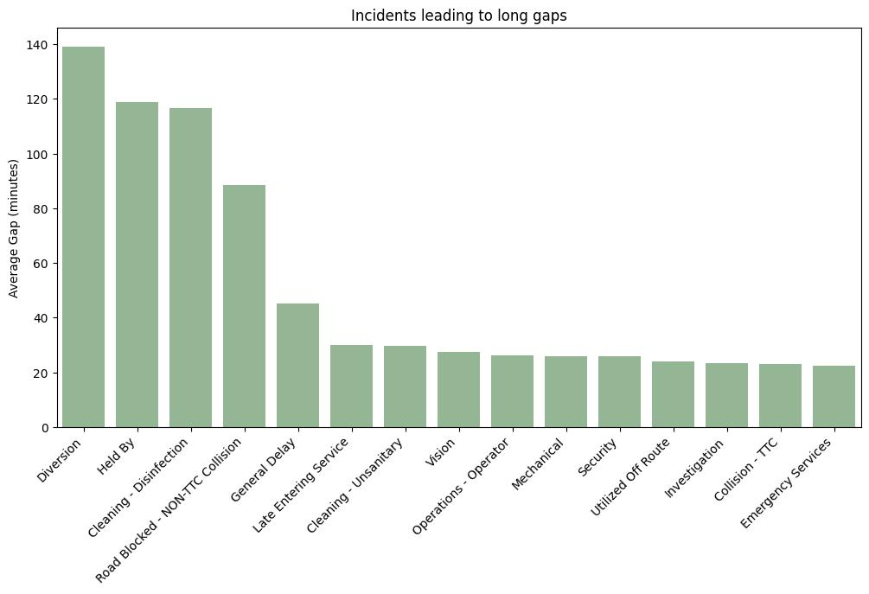

Slide 4
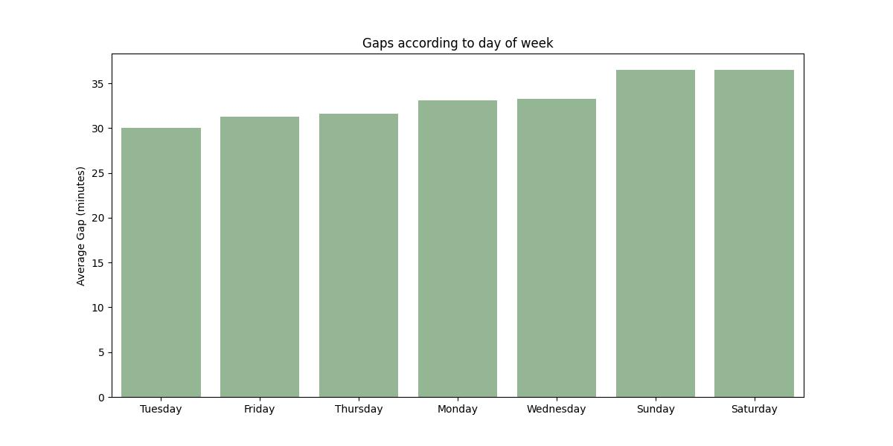
On Saturday there is the largest delay gap between busses.

Slide 5
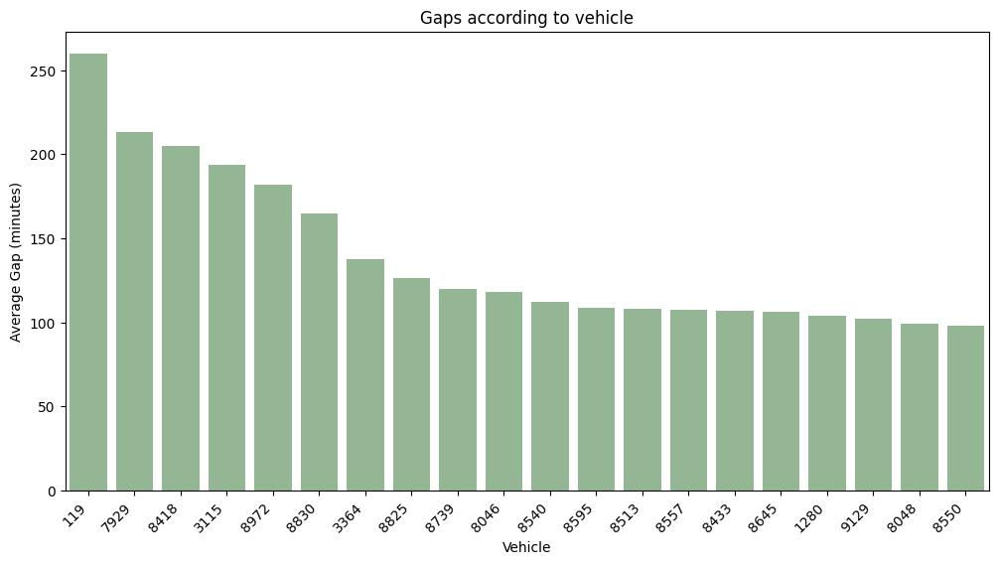
Some Vehicles have longer average gaps.

Slide 6
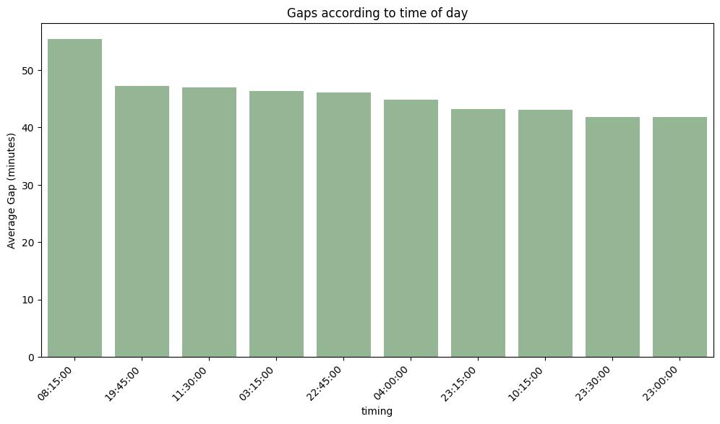
Need to implement solutions for timings with greater average gap between busses

